Slide 1
Chapter 1. Basic Structure of Computers

Slide 2
Functional Units

Slide 3
Functional Units
Arithmetic
Input
and
logic
Memory
Output
Control
I/O
Processor
Figure 1.1. Basic functional units of a computer.

Slide 4
Information Handled by a Computer
Instructions/machine instructions
Govern the transfer of information within a computer as well as between the computer and its I/O devices
Specify the arithmetic and logic operations to be performed
Program
Data
Used as operands by the instructions
Source program
Encoded in binary code – 0 and 1

Slide 5
Memory Unit
Store programs and data
Two classes of storage
Primary storage
Fast
Programs must be stored in memory while they are being executed
Large number of semiconductor storage cells
Processed in words
Address
RAM and memory access time
Memory hierarchy – cache, main memory
Secondary storage – larger and cheaper

Slide 6
Arithmetic and Logic Unit (ALU)
Most computer operations are executed in ALU of the processor.
Load the operands into memory – bring them to the processor – perform operation in ALU – store the result back to memory or retain in the processor.
Registers
Fast control of ALU

Slide 7
Arithmetic and Logic Unit (ALU)
Most computer operations are executed in ALU of the processor.
Load the operands into memory – bring them to the processor – perform operation in ALU – store the result back to memory or retain in the processor.
Registers
Fast control of ALU

Slide 8
Control Unit
All computer operations are controlled by the control unit.
The timing signals that govern the I/O transfers are also generated by the control unit.
Control unit is usually distributed throughout the machine instead of standing alone.
Operations of a computer:
Accept information in the form of programs and data through an input unit and store it in the memory
Fetch the information stored in the memory, under program control, into an ALU, where the information is processed
Output the processed information through an output unit
Control all activities inside the machine through a control unit

Slide 9
Basic Operational Concepts

Slide 10
Review
Activity in a computer is governed by instructions.
To perform a task, an appropriate program consisting of a list of instructions is stored in the memory.
Individual instructions are brought from the memory into the processor, which executes the specified operations.
Data to be used as operands are also stored in the memory.

Slide 11
A Typical Instruction
Add LOCA, R0
Add the operand at memory location LOCA to the operand in a register R0 in the processor.
Place the sum into register R0.
The original contents of LOCA are preserved.
The original contents of R0 is overwritten.
Instruction is fetched from the memory into the processor – the operand at LOCA is fetched and added to the contents of R0 – the resulting sum is stored in register R0.

Slide 12
Separate Memory Access and ALU Operation
Load LOCA, R1
Add R1, R0
Whose contents will be overwritten?

Slide 13
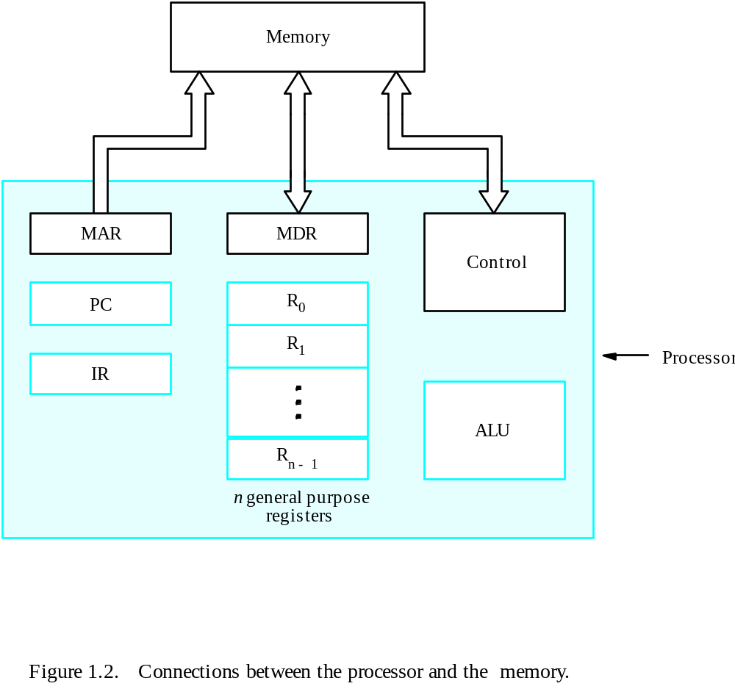
Connection Between the Processor and the Memory

Slide 14
Registers
Instruction register (IR)
Program counter (PC)
General-purpose register (R₀ – R_{n-1})
Memory address register (MAR)
Memory data register (MDR)

Slide 15
Typical Operating Steps
Programs reside in the memory through input devices
PC is set to point to the first instruction
The contents of PC are transferred to MAR
A Read signal is sent to the memory
The first instruction is read out and loaded into MDR
The contents of MDR are transferred to IR
Decode and execute the instruction

Slide 16
Typical Operating Steps (Cont’)
Get operands for ALU
  General-purpose register
  Memory (address to MAR – Read – MDR to ALU)
Perform operation in ALU
Store the result back
  To general-purpose register
  To memory (address to MAR, result to MDR – Write)
During the execution, PC is incremented to the next instruction

Slide 17
Interrupt
Normal execution of programs may be preempted if some device requires urgent servicing.
The normal execution of the current program must be interrupted – the device raises an interrupt signal.
Interrupt-service routine
Current system information backup and restore (PC, general-purpose registers, control information, specific information)

Slide 18
Bus Structures
There are many ways to connect different parts inside a computer together.
A group of lines that serves as a connecting path for several devices is called a bus.
Address/data/control

Slide 19
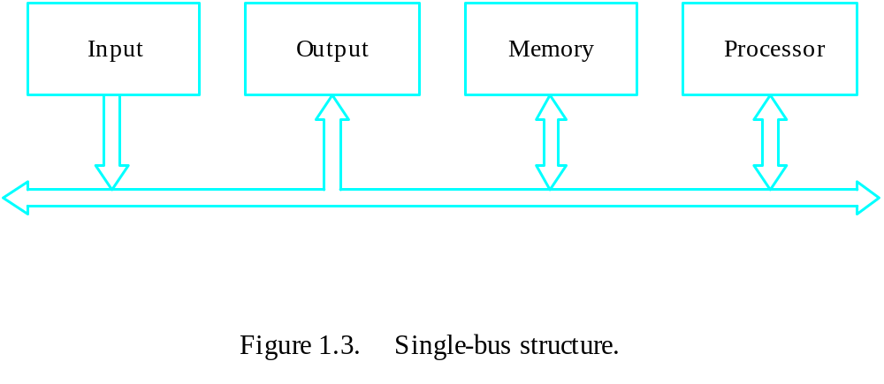
Bus Structure
Single-bus

Slide 20
Speed Issue
Different devices have different transfer/operate speed.
If the speed of bus is bounded by the slowest device connected to it, the efficiency will be very low.
How to solve this?
A common approach – use buffers.

Slide 21
Performance

Slide 22
Performance
The most important measure of a computer is how quickly it can execute programs.
Three factors affect performance:
Hardware design
Instruction set
Compiler

Slide 23
Performance
Processor time to execute a program depends on the hardware involved in the execution of individual machine instructions.
Main
Cache
memory
memory
Processor
Bus
Figure 1.5.
The processor cache.

Slide 24
Performance
The processor and a relatively small cache memory can be fabricated on a single integrated circuit chip.
Speed
Cost
Memory management

Slide 25
Processor Clock
Clock, clock cycle, and clock rate
The execution of each instruction is divided into several steps, each of which completes in one clock cycle.
Hertz – cycles per second

Slide 26
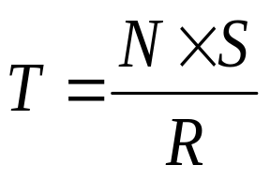
Basic Performance Equation
T – processor time required to execute a program that has been prepared in high-level language
N – number of actual machine language instructions needed to complete the execution (note: loop)
S – average number of basic steps needed to execute one machine instruction. Each step completes in one clock cycle
R – clock rate
Note: these are not independent to each other
How to improve T?

Slide 27
Clock Rate
Increase clock rate
Improve the integrated-circuit (IC) technology to make the circuits faster
Reduce the amount of processing done in one basic step (however, this may increase the number of basic steps needed)
Increases in R that are entirely caused by improvements in IC technology affect all aspects of the processor’s operation equally except the time to access the main memory.

Slide 28
Compiler
A compiler translates a high-level language program into a sequence of machine instructions.
To reduce N, we need a suitable machine instruction set and a compiler that makes good use of it.
Goal – reduce N×S
A compiler may not be designed for a specific processor; however, a high-quality compiler is usually designed for, and with, a specific processor.

Slide 29
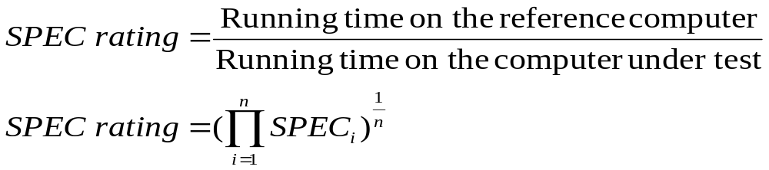
Performance Measurement
T is difficult to compute.
Measure computer performance using benchmark programs.
System Performance Evaluation Corporation (SPEC) selects and publishes representative application programs for different application domains, together with test results for many commercially available computers.
Compile and run (no simulation)
Reference computer

Slide 30
Chapter 2. Machine Instructions and Programs

Slide 31
Objectives
Machine instructions and program execution, including branching and subroutine call and return operations.
Number representation and addition/subtraction in the 2’s-complement system.
Addressing methods for accessing register and memory operands.
Assembly language for representing machine instructions, data, and programs.
Program-controlled Input/Output operations.

Slide 32
Number, Arithmetic Operations, and Characters

Slide 33
Signed Integer
3 major representations:
Sign and magnitude
One’s complement
Two’s complement
Assumptions:
4-bit machine word
16 different values can be represented
Roughly half are positive, half are negative

Slide 34
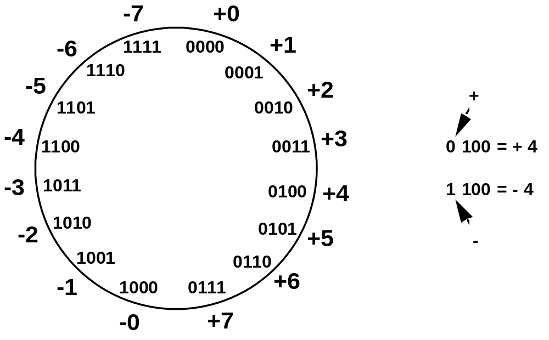
Sign and Magnitude Representation
High order bit is sign: 0 = positive (or zero), 1 = negative
Three low order bits is the magnitude: 0 (000) thru 7 (111)
Number range for n bits = +/-2^{n-1} -1
Two representations for 0

Slide 35
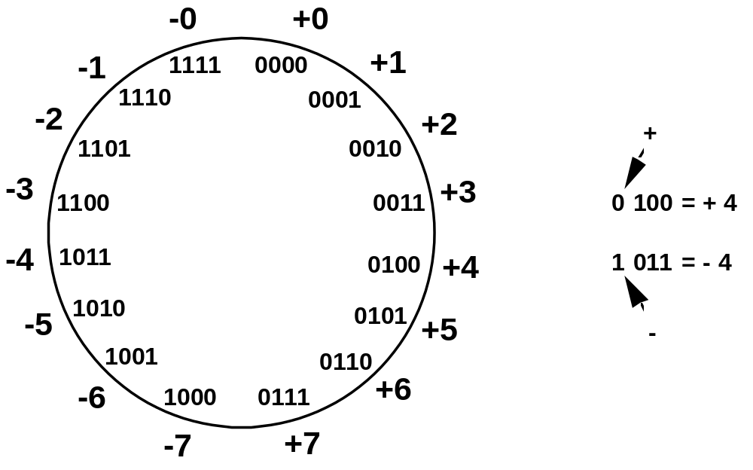
One’s Complement Representation
Subtraction implemented by addition & 1's complement
Still two representations of 0! This causes some problems
Some complexities in addition

Slide 36
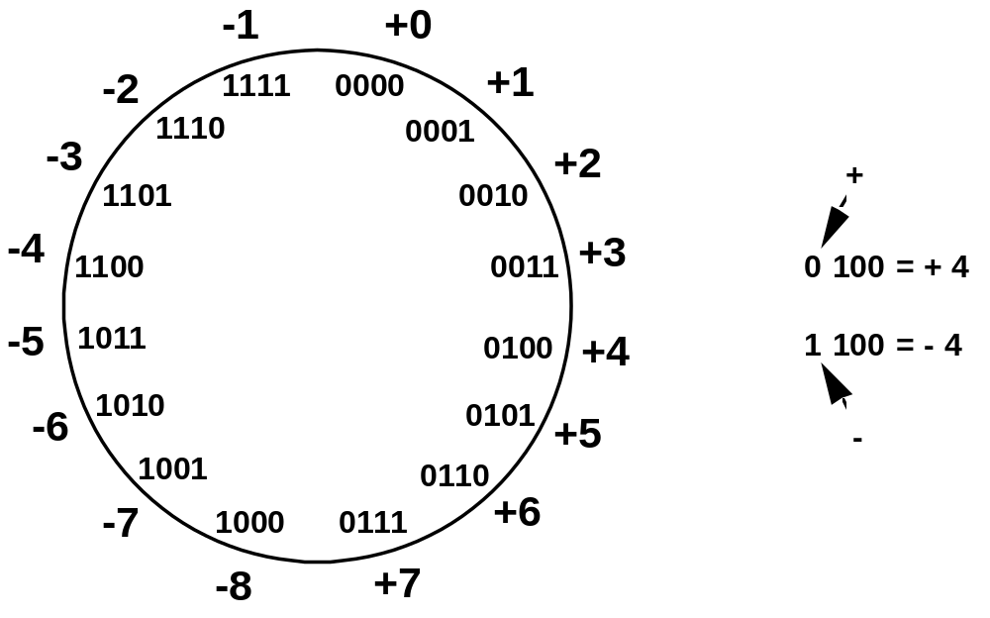
Two’s Complement Representation
like 1's comp
except shifted
one position
clockwise
Only one representation for 0
One more negative number than positive number

Slide 37
Binary, Signed-Integer Representations
Page 28
B
V
alues represented
Sign and
b
3
b
2
b
1
b
0
magnitude
1'
s complement
2'
s complement
0
1
1
1
+
7
+
7
+
7
0
1
1
0
+
6
+
6
+
6
0
1
0
1
+
5
+
5
+
5
0
1
0
0
+
4
+
4
+
4
0
0
1
1
+
3
+
3
+
3
0
0
1
0
+
2
+
2
+
2
0
0
0
1
+
1
+
1
+
1
0
0
0
0
+
0
+
0
+
0
1
0
0
0
-
0
-
7
-
8
1
0
0
1
-
1
-
6
-
7
1
0
1
0
-
2
-
5
-
6
1
0
1
1
-
3
-
4
-
5
1
1
0
0
-
4
-
3
-
4
1
1
0
1
-
5
-
2
-
3
1
1
1
0
-
6
-
1
-
2
1
1
1
1
-
7
-
0
-
1
Figure 2.1. Binary, signed-integer representations.

Slide 38
Addition and Subtraction – 2’s Complement
4
+ 3
7
0100
0011
0111
-4
+ (-3)
-7
1100
1101
11001
If carry-in to the high
order bit =
carry-out then ignore
carry
if carry-in differs from
carry-out then overflow
4
- 3
1
0100
1101
10001
-4
+ 3
-1
1100
0011
1111
Simpler addition scheme makes twos complement the most common
choice for integer number systems within digital systems

Slide 39
2’s-Complement Add and Subtract Operations
(a)
0 0 1 0
(
+
2
)
(b)
0 1 0 0
(
+
4
)
Page 31
+
0 0 1 1
(
+
3
)
+
1 0 1 0
(
-
6
)
0 1 0 1
(
+
5
)
1 1 1 0
(
-
2
)
(c)
1 0 1 1
(
-
5
)
(d)
0 1 1 1
(
+
7
)
+
1 1 1 0
(
-
2
)
+
1 1 0 1
(
-
3
)
1 0 0 1
(
-
7
)
0 1 0 0
(
+
4
)
(e)
1 1 0 1
(
-
3
)
1 1 0 1
-
1 0 0 1
(
-
7
)
+
0 1 1 1
0 1 0 0
(
+
4
)
(f)
0 0 1 0
(
+
2
)
0 0 1 0
-
0 1 0 0
(
+
4
)
+
1 1 0 0
1 1 1 0
(
-
2
)
(g)
0 1 1 0
(
+
6
)
0 1 1 0
-
0 0 1 1
(
+
3
)
+
1 1 0 1
0 0 1 1
(
+
3
)
(h)
1 0 0 1
(
-
7
)
1 0 0 1
-
1 0 1 1
(
-
5
)
+
0 1 0 1
1 1 1 0
(
-
2
)
(i)
1 0 0 1
(
-
7
)
1 0 0 1
-
0 0 0 1
(
+
1
)
+
1 1 1 1
1 0 0 0
(
-
8
)
(j)
0 0 1 0
(
+
2
)
0 0 1 0
-
1 1 0 1
(
-
3
)
+
0 0 1 1
0 1 0 1
(
+
5
)
Figure 2.4. 2's-complement Add and Subtract operations.

Slide 40
Overflow - Add two positive numbers to get a negative number or two negative numbers to get a positive number
-1
+0
-1
+0
-2
1111
0000
+1
-2
1111
0000
+1
-3
1110
0001
-3
1110
0001
1101
+2
1101
+2
-4
0010
-4
0010
1100
0011
+3
1100
0011
+3
-5
1011
-5
0100
+4
1011
0100
+4
-6
1010
-6
1010
0101
+5
0101
+5
1001
0110
1001
0110
-7
1000
+6
-7
+6
0111
1000
0111
-8
+7
-8
+7
5 + 3 = -8
-7 - 2 = +7

Slide 41
Overflow Conditions
0 1 1 1
0 1 0 1
0 0 1 1
1 0 0 0
1 0 0 0
1 0 0 1
1 1 0 0
1 0 1 1 1
5
3
-8
-7
-2
7
Overflow
Overflow
0 0 0 0
0 1 0 1
0 0 1 0
0 1 1 1
1 1 1 1
1 1 0 1
1 0 1 1
1 1 0 0 0
5
2
7
-3
-5
-8
No overflow
No overflow
Overflow when carry-in to the high-order bit does not equal carry out

Slide 42
Sign Extension
Task:
  Given w-bit signed integer x
  Convert it to w+k-bit integer with same value
Rule:
  Make k copies of sign bit:
  X ′ = x_{w–1} ,…, x_{w–1} , x_{w–1} , x_{w–2} ,…, x₀
w
X
• • •
k copies of MSB
• • •
X ′
• • •
• • •
k
w

Slide 43
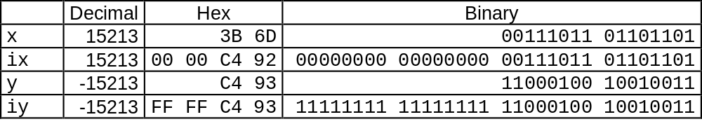
Sign Extension Example
short int x = 15213;
int ix = (int) x;
short int y = -15213;
int iy = (int) y;

Slide 44
Memory Locations, Addresses, and Operations

Slide 45
Memory Location, Addresses, and Operation
n
bits
Memory consists of many millions of storage cells, each of which can store 1 bit.
Data is usually accessed in n-bit groups. n is called word length.
first word
second word
•
•
•
i
th word
•
•
•
last word
Figure 2.5. Memory words.

Slide 46
Memory Location, Addresses, and Operation
32-bit word length example
32 bits
•
•
•
b
31
b
30
b
1
b
0
Sign bit:
b
31
=
0
for positive numbers
b
31
=
1
for negative numbers
(a) A signed integer
8 bits
8 bits
8 bits
8 bits
ASCII
ASCII
ASCII
ASCII
character
character
character
character
(b) Four characters

Slide 47
Memory Location, Addresses, and Operation
To retrieve information from memory, either for one word or one byte (8-bit), addresses for each location are needed.
A k-bit address memory has 2^{k} memory locations, namely 0 – 2^{k}-1, called memory space.
24-bit memory: 2²⁴ = 16,777,216 = 16M (1M=2²⁰)
32-bit memory: 2³² = 4G (1G=2³⁰)
1K(kilo)=2¹⁰
1T(tera)=2⁴⁰

Slide 48
Memory Location, Addresses, and Operation
It is impractical to assign distinct addresses to individual bit locations in the memory.
The most practical assignment is to have successive addresses refer to successive byte locations in the memory – byte-addressable memory.
Byte locations have addresses 0, 1, 2, … If word length is 32 bits, they successive words are located at addresses 0, 4, 8,…

Slide 49
Big-Endian and Little-Endian Assignments
Big-Endian: lower byte addresses are used for the most significant bytes of the word
Little-Endian: opposite ordering. lower byte addresses are used for the less significant bytes of the word
W
ord
address
Byte address
Byte address
0
0
1
2
3
0
3
2
1
0
4
4
5
6
7
4
7
6
5
4
•
•
•
•
•
•
2
k
-
4
2
k
-
4
2
k
-
3
2
k
-
2
2
k
-
1
2
k
-
4
2
k
-
1
2
k
-
2
2
k
-
3
2
k
-
4
(a) Big-endian assignment
(b) Little-endian assignment
Figure 2.7. Byte and word addressing.

Slide 50
Memory Location, Addresses, and Operation
Address ordering of bytes
Word alignment
  Words are said to be aligned in memory if they begin at a byte addr. that is a multiple of the num of bytes in a word.
    16-bit word: word addresses: 0, 2, 4,….
    32-bit word: word addresses: 0, 4, 8,….
    64-bit word: word addresses: 0, 8,16,….
Access numbers, characters, and character strings

Slide 51
Memory Operation
Load (or Read or Fetch)
Copy the content. The memory content doesn’t change.
Address – Load
Registers can be used
Store (or Write)
Overwrite the content in memory
Address and Data – Store
Registers can be used

Slide 52
Instruction and Instruction Sequencing

Slide 53
“Must-Perform” Operations
Data transfers between the memory and the processor registers
Arithmetic and logic operations on data
Program sequencing and control
I/O transfers

Slide 54
Register Transfer Notation
Identify a location by a symbolic name standing for its hardware binary address (LOC, R0,…)
Contents of a location are denoted by placing square brackets around the name of the location (R1←[LOC], R3 ←[R1]+[R2])
Register Transfer Notation (RTN)

Slide 55
Assembly Language Notation
Represent machine instructions and programs.
Move LOC, R1 = R1←[LOC]
Add R1, R2, R3 = R3 ←[R1]+[R2]

Slide 56
CPU Organization
Single Accumulator
  Result usually goes to the Accumulator
  Accumulator has to be saved to memory quite often
General Register
  Registers hold operands thus reduce memory traffic
  Register bookkeeping
Stack
  Operands and result are always in the stack

Slide 57
Instruction Formats
Three-Address Instructions
  ADD R1, R2, R3 R1 ← R2 + R3
Two-Address Instructions
  ADD R1, R2 R1 ← R1 + R2
One-Address Instructions
  ADD M AC ← AC + M[AR]
Zero-Address Instructions
  ADD TOS ← TOS + (TOS – 1)
RISC Instructions
  Lots of registers. Memory is restricted to Load & Store
Instruction
Opcode
Operand(s) or Address(es)

Slide 58
Instruction Formats
Example: Evaluate (A+B) ∗ (C+D)
Three-Address
  ADD R1, A, B ; R1 ← M[A] + M[B]
  ADD R2, C, D ; R2 ← M[C] + M[D]
  MUL X, R1, R2 ; M[X] ← R1 ∗ R2

Slide 59
Instruction Formats
Example: Evaluate (A+B) ∗ (C+D)
Two-Address
  MOV R1, A ; R1 ← M[A]
  ADD R1, B ; R1 ← R1 + M[B]
  MOV R2, C ; R2 ← M[C]
  ADD R2, D ; R2 ← R2 + M[D]
  MUL R1, R2 ; R1 ← R1 ∗ R2
  MOV X, R1 ; M[X] ← R1

Slide 60
Instruction Formats
Example: Evaluate (A+B) ∗ (C+D)
One-Address
  LOAD A ; AC ← M[A]
  ADD B ; AC ← AC + M[B]
  STORE T ; M[T] ← AC
  LOAD C ; AC ← M[C]
  ADD D ; AC ← AC + M[D]
  MUL T ; AC ← AC ∗ M[T]
  STORE X ; M[X] ← AC

Slide 61
Instruction Formats
Example: Evaluate (A+B) ∗ (C+D)
Zero-Address
  PUSH A ; TOS ← A
  PUSH B ; TOS ← B
  ADD ; TOS ← (A + B)
  PUSH C ; TOS ← C
  PUSH D ; TOS ← D
  ADD ; TOS ← (C + D)
  MUL ; TOS ← (C+D)∗(A+B)
  POP X ; M[X] ← TOS

Slide 62
Instruction Formats
Example: Evaluate (A+B) ∗ (C+D)
RISC
  LOAD R1, A ; R1 ← M[A]
  LOAD R2, B ; R2 ← M[B]
  LOAD R3, C ; R3 ← M[C]
  LOAD R4, D ; R4 ← M[D]
  ADD R1, R1, R2 ; R1 ← R1 + R2
  ADD R3, R3, R4 ; R3 ← R3 + R4
  MUL R1, R1, R3 ; R1 ← R1 ∗ R3
  STORE X, R1 ; M[X] ← R1

Slide 63
Using Registers
Registers are faster
Shorter instructions
  The number of registers is smaller (e.g. 32 registers need 5 bits)
Potential speedup
Minimize the frequency with which data is moved back and forth between the memory and processor registers.

Slide 64
Instruction Execution and Straight-Line Sequencing
Address
Contents
Assumptions:
- One memory operand
per instruction
- 32-bit word length
- Memory is byte
addressable
- Full memory address
can be directly specified
in a single-word instruction
Begin execution here
i
Move
A,R0
3-instruction
i
+ 4
Add
B,R0
program
segment
i
+ 8
Move
R0,C
A
B
Data for
the program
Two-phase procedure
Instruction fetch
Instruction execute
C
Page 43
Figure 2.8. A program for C ← [Α] + [Β].

Slide 65
Branching
i
Move
NUM1,R0
i
+
4
Add
NUM2,R0
i
+
8
Add
NUM3,R0
•
•
•
i
+
4
n
-
4
Add
NUM
n
,R0
i
+
4
n
Move
R0,SUM
•
•
•
SUM
NUM1
NUM2
•
•
•
NUM
n
Figure 2.9. A straight-line program for adding n numbers.

Slide 66
Branching
Move
N,R1
Clear
R0
LOOP
Determine address of
"Next" number and add
Program
"Next" number to R0
loop
Decrement
R1
Branch target
Branch>0
LOOP
Move
R0,SUM
Conditional branch
•
•
•
SUM
N
n
NUM1
Figure 2.10. Using a loop to add n numbers.
NUM2
•
•
•
NUM
n

Slide 67
Condition Codes
Condition code flags
Condition code register / status register
N (negative)
Z (zero)
V (overflow)
C (carry)
Different instructions affect different flags

Slide 68
Conditional Branch Instructions
A: 1 1 1 1 0 0 0 0
Example:
  A: 1 1 1 1 0 0 0 0
  B: 0 0 0 1 0 1 0 0
+(−B): 1 1 1 0 1 1 0 0
1 1 0 1 1 1 0 0
C = 1
Z = 0
S = 1
V = 0

Slide 69

Status Bits
C_{n-1}
A
B
C_{n}
ALU
F
V
Z
S
C
F_{n-1}
Zero Check

Slide 70
Addressing Modes

Slide 71
Generating Memory Addresses
How to specify the address of branch target?
Can we give the memory operand address directly in a single Add instruction in the loop?
Use a register to hold the address of NUM1; then increment by 4 on each pass through the loop.

Slide 72
Addressing Modes
Implied
  AC is implied in “ADD M[AR]” in “One-Address” instr.
  TOS is implied in “ADD” in “Zero-Address” instr.
Immediate
  The use of a constant in “MOV R1, 5”, i.e. R1 ← 5
Register
  Indicate which register holds the operand
Instruction
Opcode
Mode
...

Slide 73
Addressing Modes
Register Indirect
  Indicate the register that holds the number of the register that holds the operand
    MOV R1, (R2)
Autoincrement / Autodecrement
  Access & update in 1 instr.
Direct Address
  Use the given address to access a memory location
R1
R2 = 3
R3 = 5

Slide 74
Addressing Modes
Indirect Address
  Indicate the memory location that holds the address of the memory location that holds the data
Memory
AR = 101
100
101
0 1 0 4
102
103
104
1 1 0 A

Slide 75
Addressing Modes
Memory
Relative Address
  EA = PC + Relative Addr
0
1
Program
PC = 2
2
+
100
Data
AR = 100
101
102
1 1 0 A
Could be Positive or Negative
(2’s Complement)
103
104

Slide 76
Addressing Modes
Indexed
  EA = Index Register + Relative Addr
Memory
Useful with “Autoincrement” or “Autodecrement”
XR = 2
+
100
AR = 100
101
Could be Positive or Negative
(2’s Complement)
102
1 1 0 A
103
104

Slide 77
Addressing Modes
Base Register
  EA = Base Register + Relative Addr
Memory
Could be Positive or Negative
(2’s Complement)
AR = 2
+
100
0 0 0 5
BR = 100
101
0 0 1 2
102
0 0 0 A
Usually points to the beginning of an array
103
0 1 0 7
104
0 0 5 9

Slide 78
Addressing Modes
Name
Assem
bler
syn
tax
Addressing
function
The different ways in which the location of an operand is specified in an instruction are referred to as addressing modes.
Immediate
#V
alue
Op
erand
=
V
alue
Register
R
i
EA
=
R
i
Absolute
(Direct)
LOC
EA
=
LOC
Indirect
(R
i
)
EA
=
[R
i
]
(LOC)
EA
=
[LOC]
Index
X(R
i
)
EA
=
[R
i
]
+
X
Base
with
index
(R
i
,R
j
)
EA
=
[R
i
]
+
[R
j
]
Base
with
index
X(R
i
,R
j
)
EA
=
[R
i
]
+
[R
j
]
+
X
and
offset
Relative
X(PC)
EA
=
[PC]
+
X
Autoincremen
t
(R
i
)+
EA
=
[R
i
]
;
Incremen
t
R
i
Autodecrement
−
(R
i
)
Decremen
t
R
i
;
EA
=
[R
i
]

Slide 79
Indexing and Arrays
Index mode – the effective address of the operand is generated by adding a constant value to the contents of a register.
Index register
X(R_{i}): EA = X + [R_{i}]
The constant X may be given either as an explicit number or as a symbolic name representing a numerical value.
If X is shorter than a word, sign-extension is needed.

Slide 80
Indexing and Arrays
In general, the Index mode facilitates access to an operand whose location is defined relative to a reference point within the data structure in which the operand appears.
Several variations:
(R_{i}, R_{j}): EA = [R_{i}] + [R_{j}]
X(R_{i}, R_{j}): EA = X + [R_{i}] + [R_{j}]

Slide 81
Relative Addressing
Relative mode – the effective address is determined by the Index mode using the program counter in place of the general-purpose register.
X(PC) – note that X is a signed number
Branch>0 LOOP
This location is computed by specifying it as an offset from the current value of PC.
Branch target may be either before or after the branch instruction, the offset is given as a singed num.

Slide 82
Additional Modes
Autoincrement mode – the effective address of the operand is the contents of a register specified in the instruction. After accessing the operand, the contents of this register are automatically incremented to point to the next item in a list.
(R_{i})+. The increment is 1 for byte-sized operands, 2 for 16-bit operands, and 4 for 32-bit operands.
Autodecrement mode: -(R_{i}) – decrement first
Move
N,R1
Move
#NUM1,R2
Initialization
Clear
R0
LOOP
Add
(R2)+,R0
Decrement
R1
Branch>0
LOOP
Move
R0,SUM
Figure 2.16. The Autoincrement addressing mode used in the program of Figure 2.12.

